Slide 1

YamuLK
A Smart Travel Planning Platform for Sri Lankan Travelers
2022/E/050 – Premarathna H.M.K.K.
2022/E/180 – Prasanjana W.T.
Department of Computer Engineering
University of Jaffna

Slide 2
Content
Introduction
Objectives
Target users
Requirement Gathering
Questionnaire Results
Questionnaire Analysis & Key Findings
User Requirements
Requirement Analysis
Mental Model

Slide 3
Introduction
Background:
Planning a domestic trip in Sri Lanka often requires using multiple platforms to search for destinations, transportation, accommodation, weather updates, and travel costs. This makes trip planning time-consuming and inefficient.
Problem Statement:
  Searching information from multiple platforms
  Difficulty estimating travel budget
  Poor itinerary planning
  Limited personalized recommendations
  Difficulty finding transportation
  Lack of weather updates
  Difficulty finding nearby attractions
Proposed Solution:
“YamuLK” is a smart travel planning platform that combines all travel planning features into one application.

Slide 4
Objectives
Main Objective:
  Develop a smart travel planning platform for Sri Lankan domestic travelers.
Specific Objectives:
  Simplify travel planning
  Provide destination recommendations
  Generate travel itineraries
  Estimate travel budget
  Suggest nearby attractions
  Display weather information
  Improve user experience

Slide 5
Target Users
Our application is designed for Sri Lankan residents who travel within Sri Lanka.
Primary User Groups:
  Budget Backpackers / University Students (18–25)
  Family Travelers
  Adventure Travelers
  Corporate Trip Planners
  Pilgrimage / Elderly Travelers

Slide 6
Requirement Gathering
Method Used:
  Google Form
Google Form:
  100 Responses
  Shared via WhatsApp and Facebook
  Covered different age groups and occupations

Slide 7
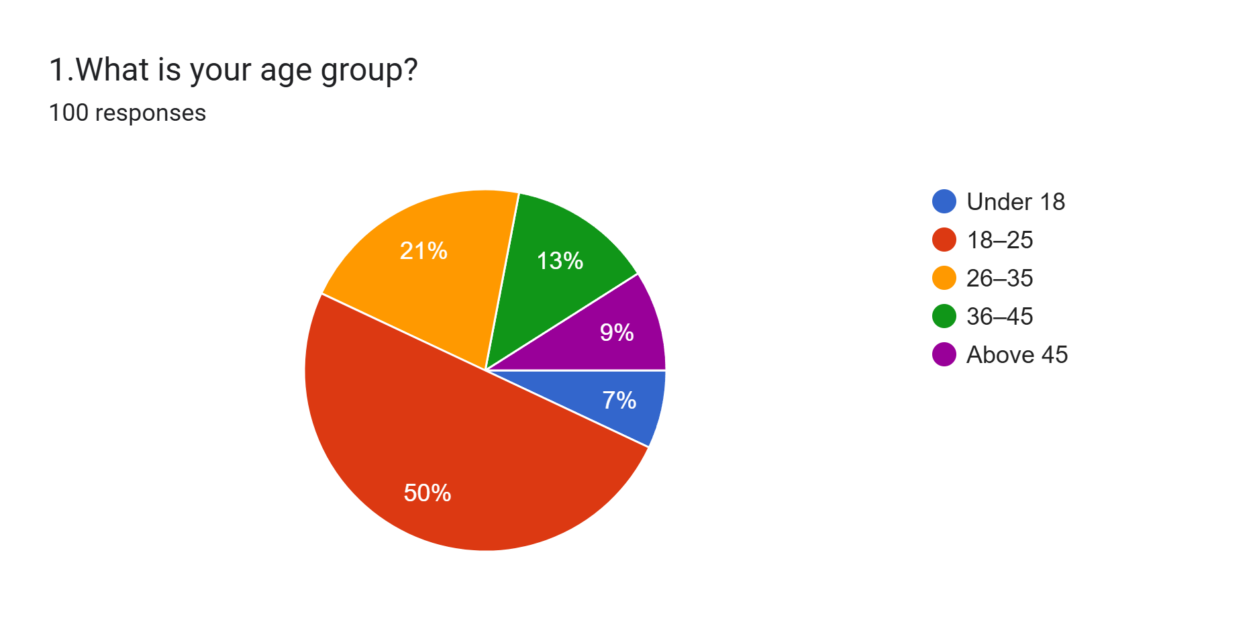
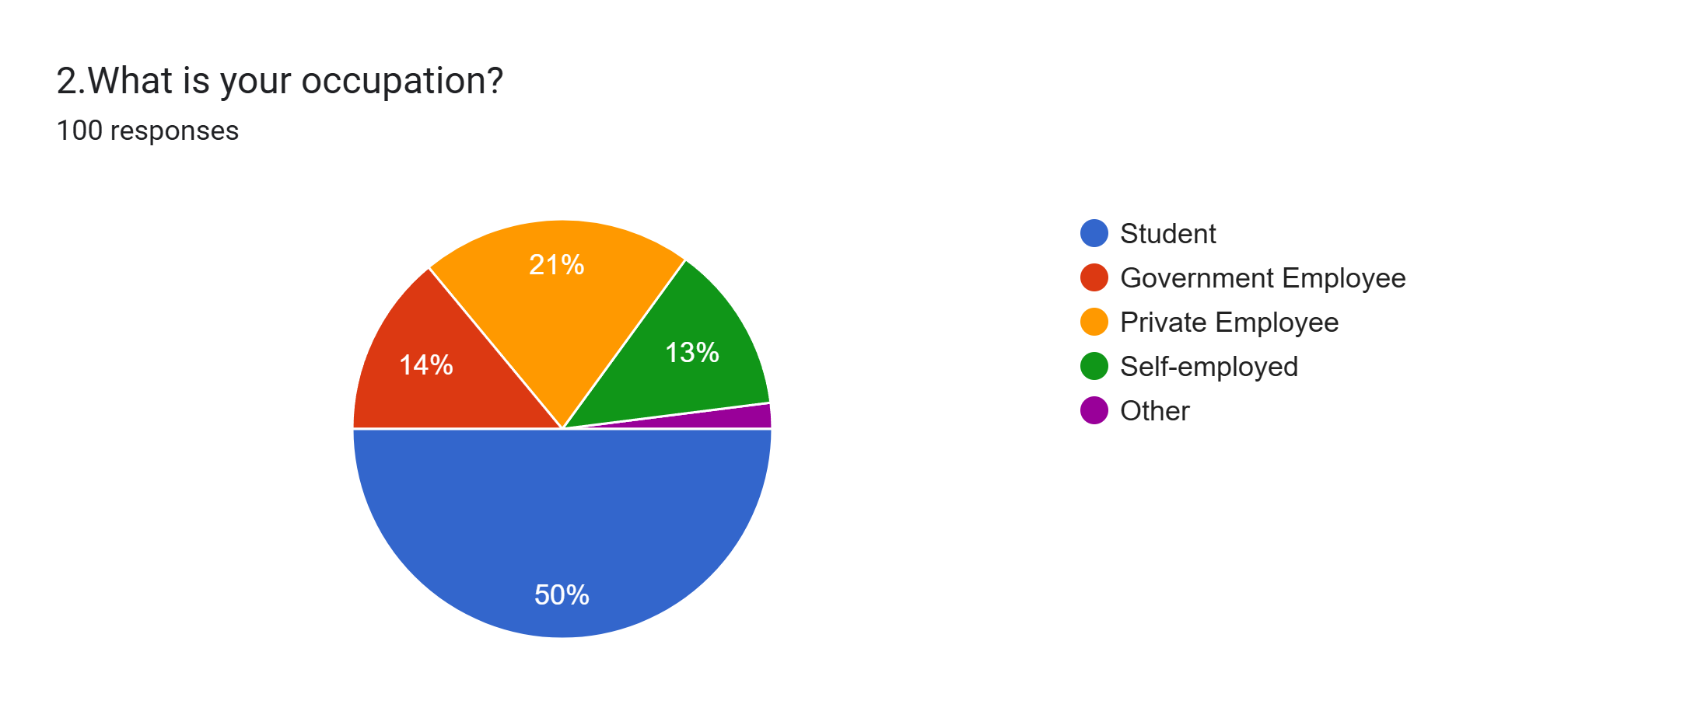
Questionnaire Results
Majority of respondents are 18–25 years old
Majority are students

Slide 8
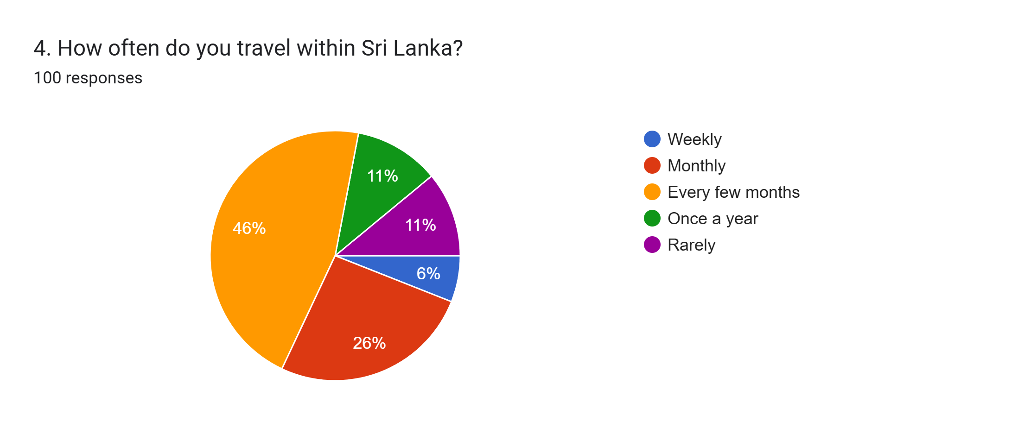
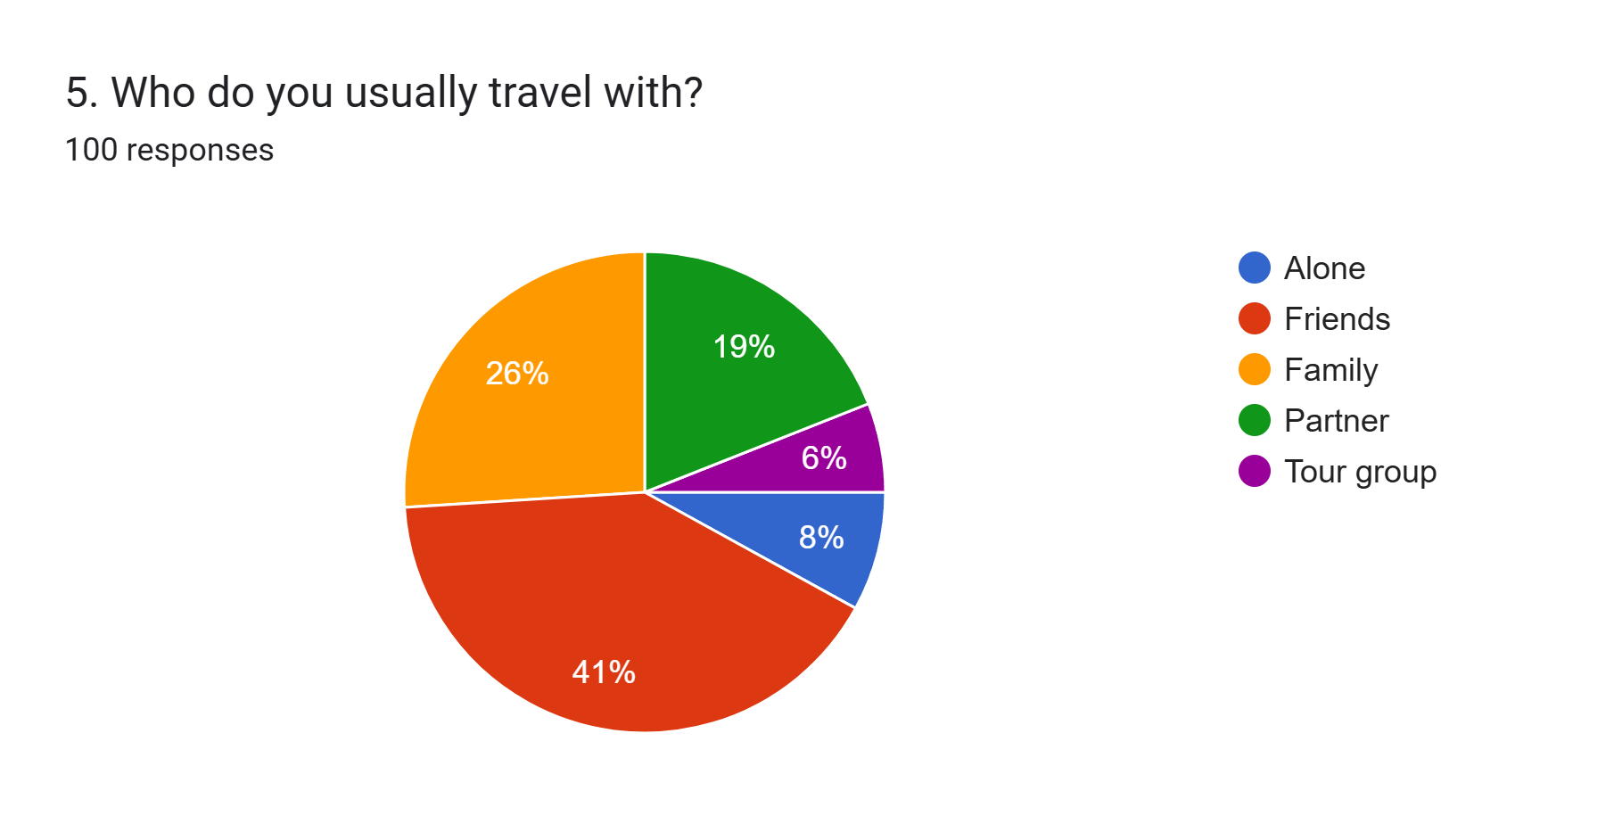
Questionnaire Results
Most travel every few months
Most travel with friends

Slide 9
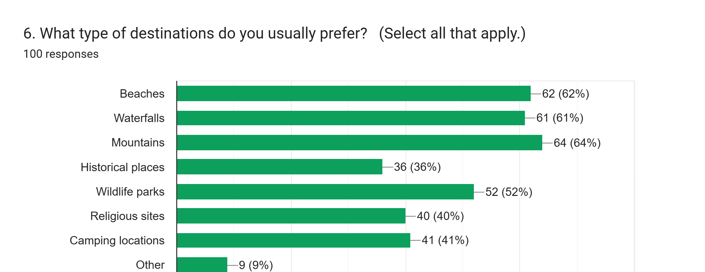
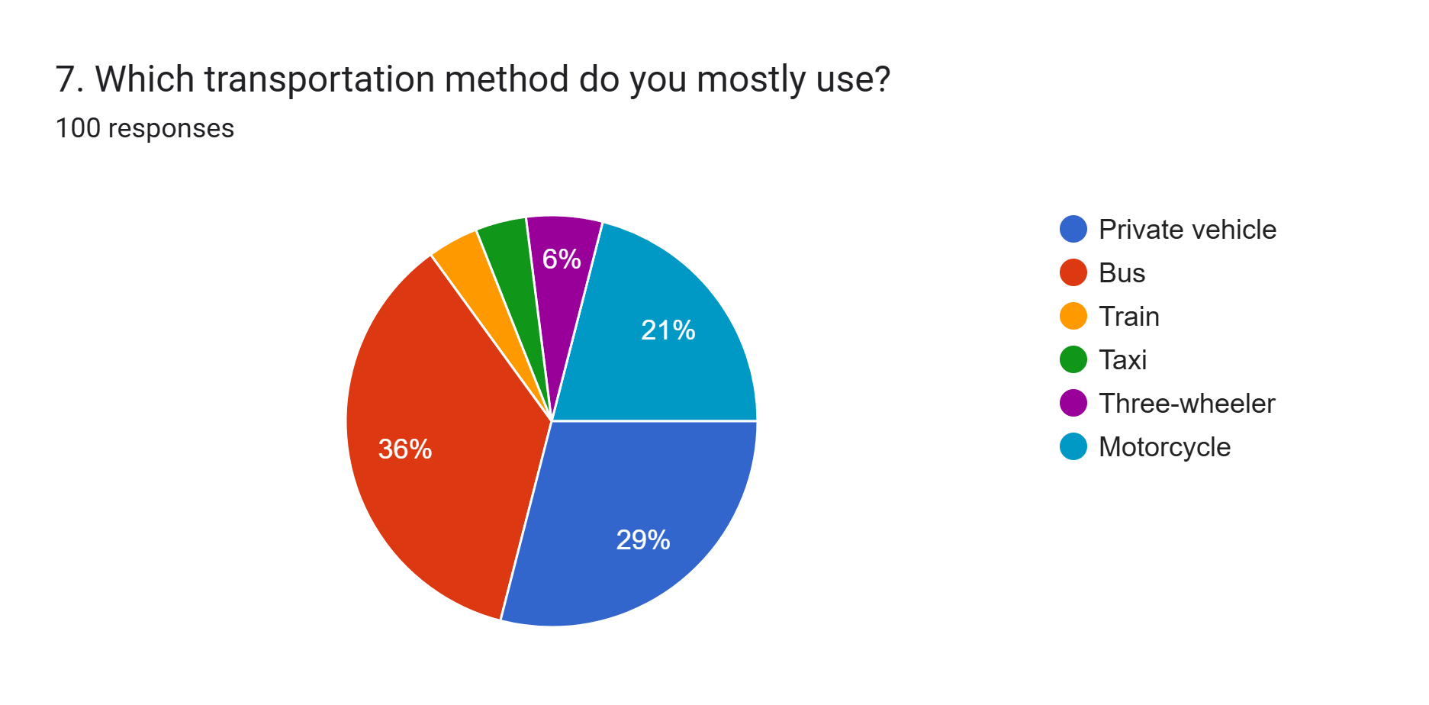
Questionnaire Analysis & Key Findings
Beaches, waterfalls, and mountains are the most popular destinations.
Buses and motorcycles are the most commonly used transportation.

Slide 10
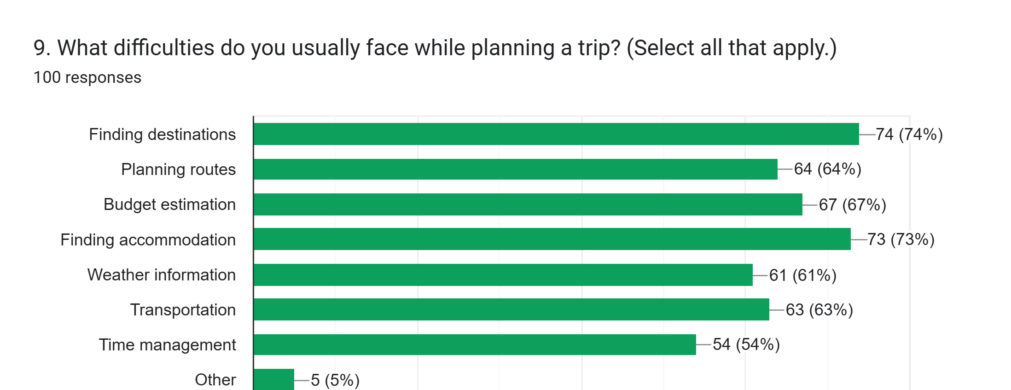
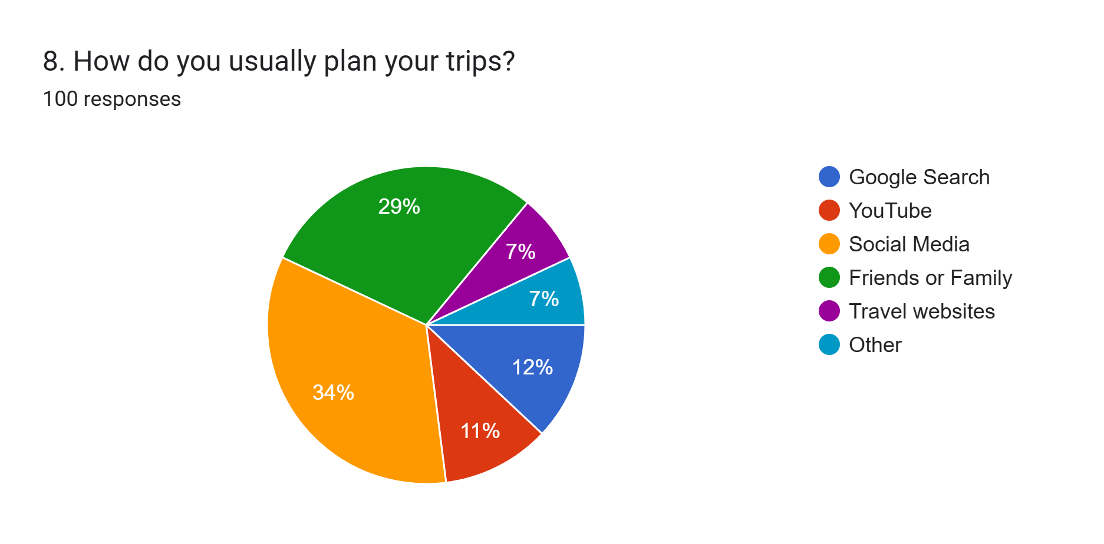
Questionnaire Analysis & Key Findings
Users mainly rely on social media and friends for trip planning.
Major problems include budget estimation, finding destinations, accommodation, and route planning.

Slide 11
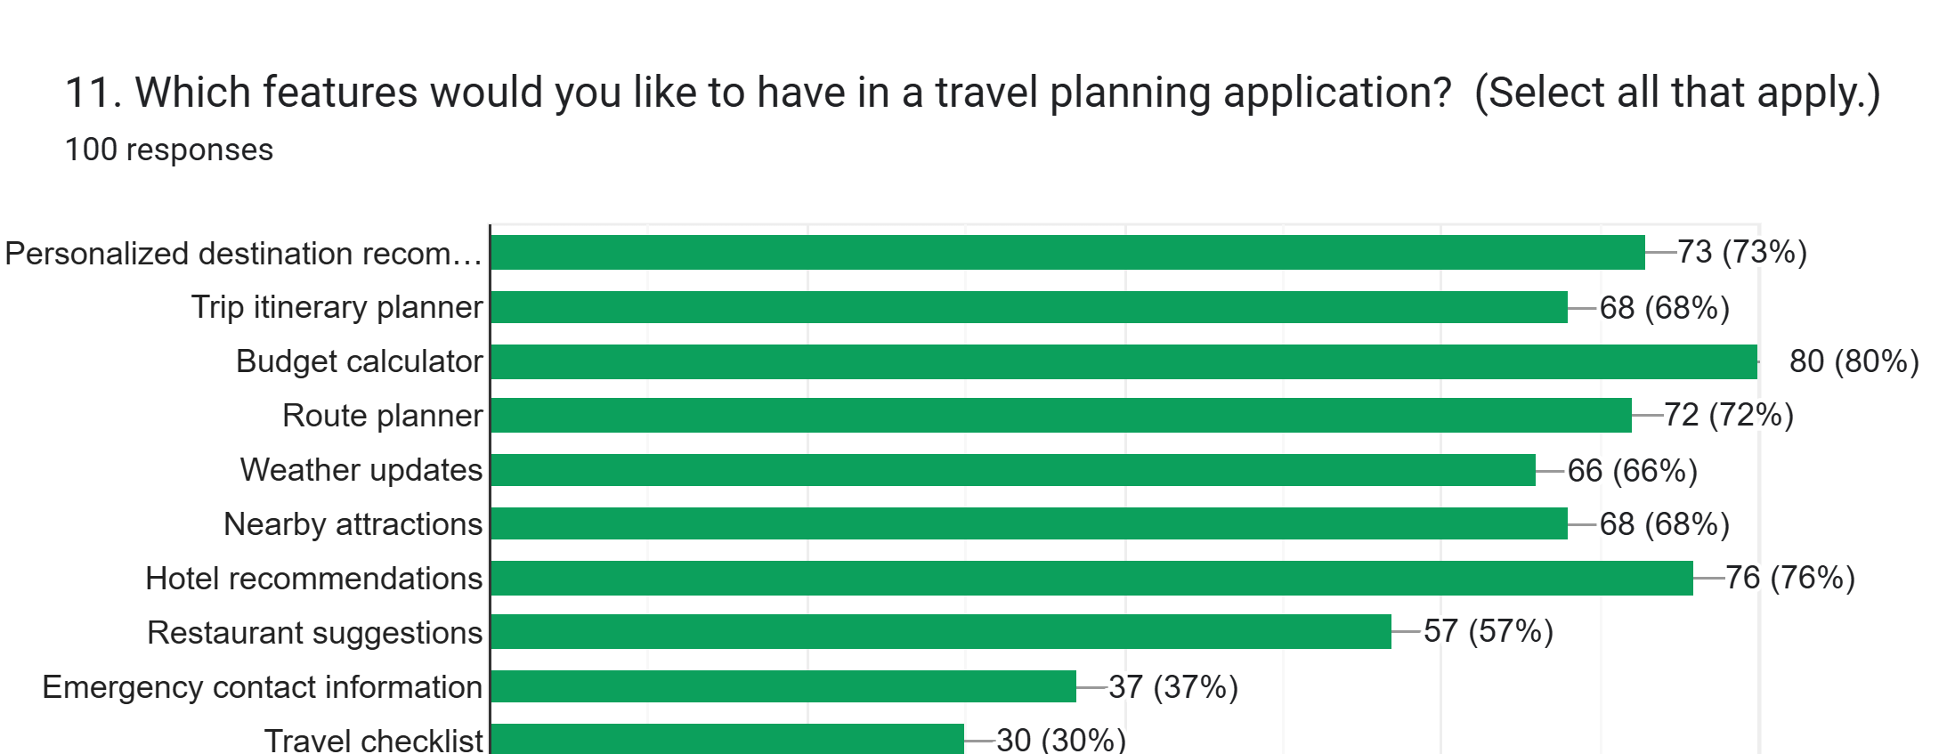
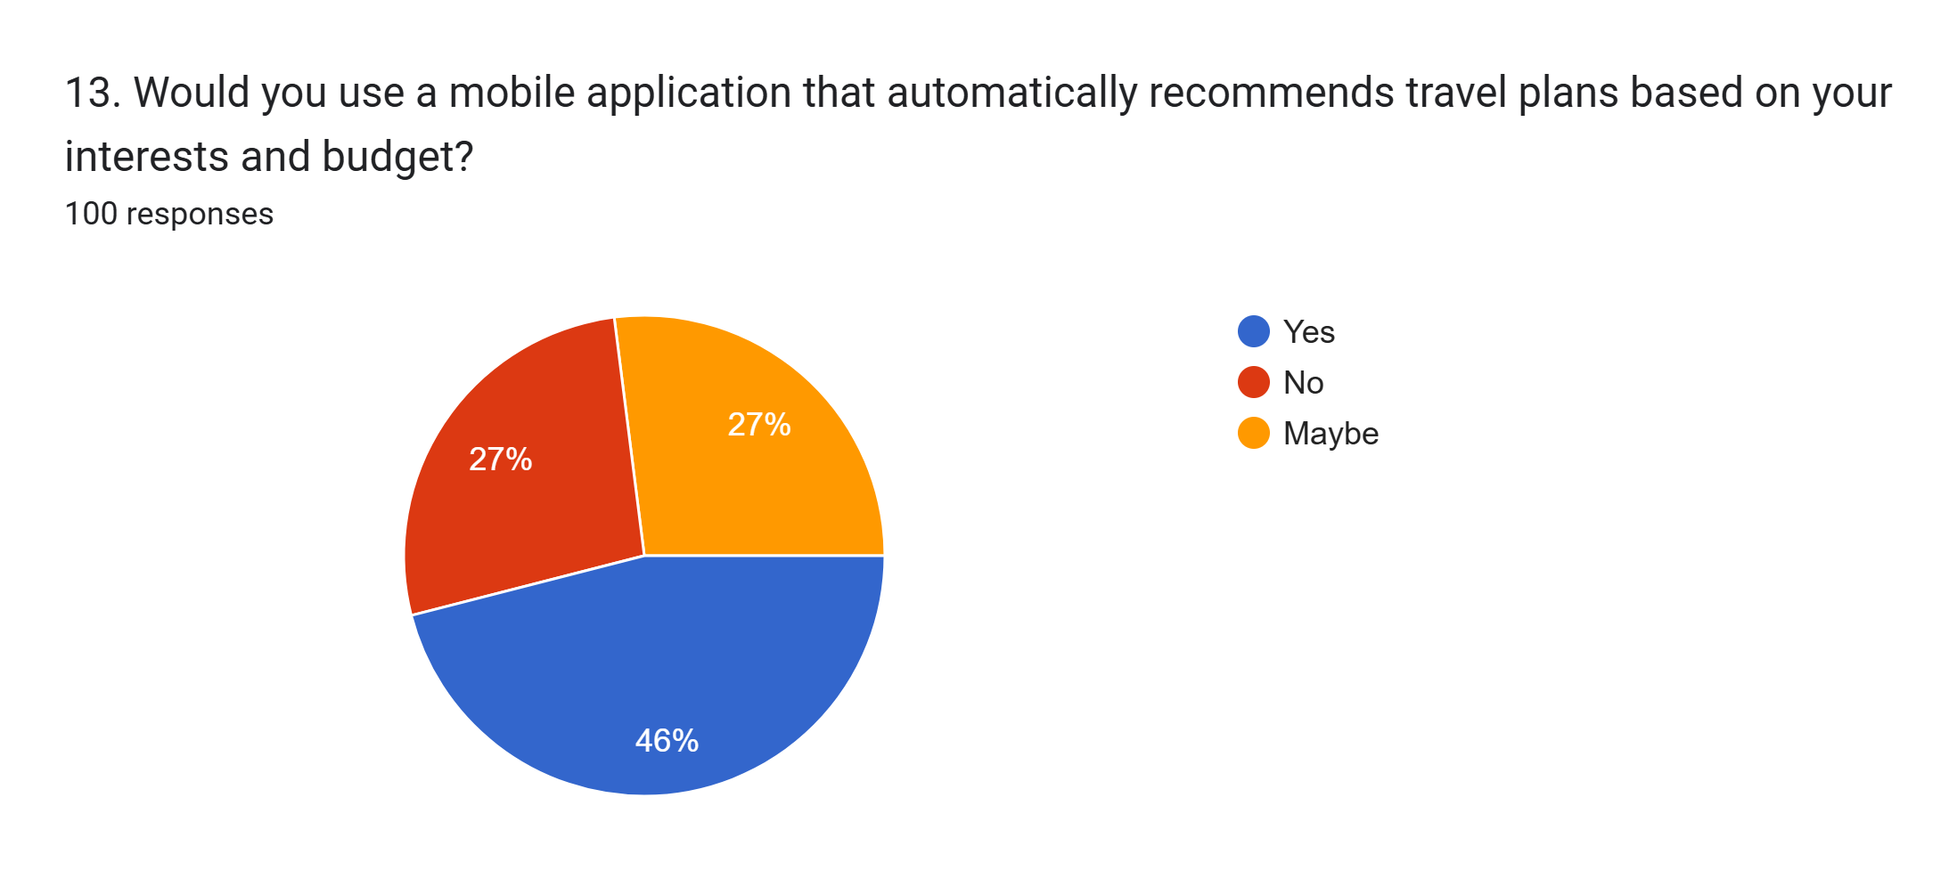
User Requirements
Route planner
Budget calculator
Hotel recommendations
Personalized destination recommendations
Many are willing to use a personalized travel planning app.

Slide 12
Requirement Analysis
Functional Requirements:
  Search tourist destinations
  Personalized recommendations
  Budget calculator
  Generate itinerary
  Route planner
  Hotel recommendations
  Restaurant suggestions
  Weather forecast
  Nearby attractions
  Save favorite places
Non-Functional Requirements:
  Easy to use
  Attractive interface
  Accurate information
  Fast response
  Mobile-friendly
  Reliable and secure

Slide 13
Mental Model
User wants to travel
Search for a destination
Compare different places
Estimate travel budget
Plan the itinerary
Find hotels & restaurants
Check weather forecast
Choose travel route
Save or share the travel plan

Slide 14
